Slide 1
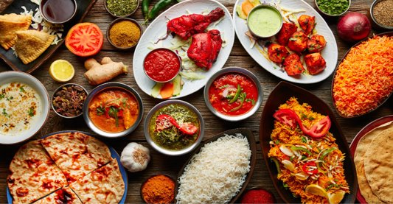
FOOD RECIPES

Slide 2
TEAM MEMBERS
Komal Moan Kamble
Kopperla Rangareddy
Jyothi DS
Kamal Kishor Hema S
FRONT END
Kudaravalli Reshma
Kunchanapalli Nikhila Hanumakonda Laxmi Sanjana
Gunji Chandra Shekar
Lingampalli Hemanth
BACKEND

Slide 3
INTRODUCTION​
A recipe is a set of instructions that describes how to prepare or make something.​
A recipe is to have a precise record of the ingredients used, how much amount of ingredients are needed and the way they are combined.

Slide 4
ABSTRACT​
The main objective of our application is to create a dynamic and responsive Java application to allow a user to register to the application and search for recipes online.
This application helps genuine food lovers to explore and have wonderful experience with the recipes uploaded.

Slide 5
MODULES FOR FOOD RECIPES
ADMIN MODULE
USER MODULE

Slide 6




TECHNOLOGIES USED :
Front-end : Angular​
Server-side: Spring Boot​
Back-end: MYSQL, Hibernate​
Server: Tomcat

Slide 7
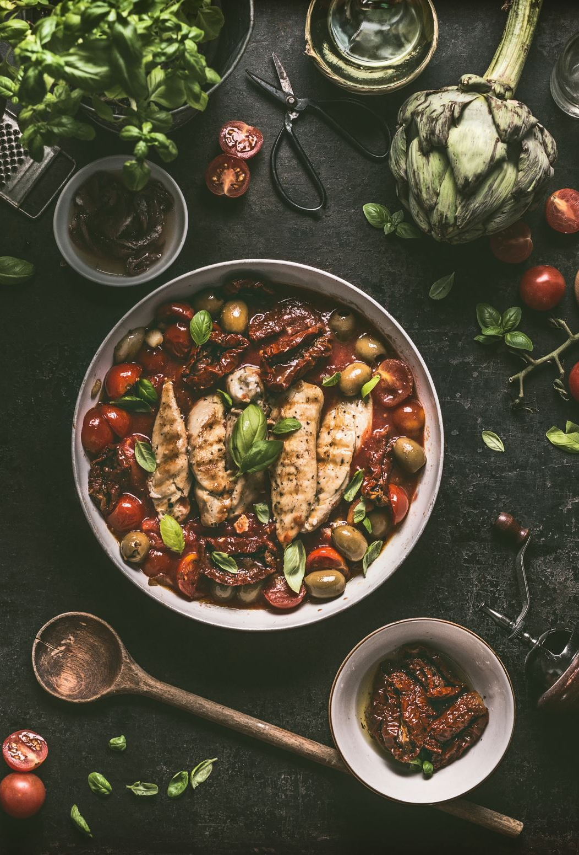
ADMIN
Admin will be able to :
Login to the portal
Admin can add / remove or even endorse a recipe
Edit recipe details like name, item details, ingredients and cooking steps

Slide 8
ADMIN FLOW
ADMIN
LOGIN
VIEW ALL
RECIPE
EDIT
RECIPE
ADD
RECIPE
REMOVE
RECIPE
LOGOUT

Slide 9
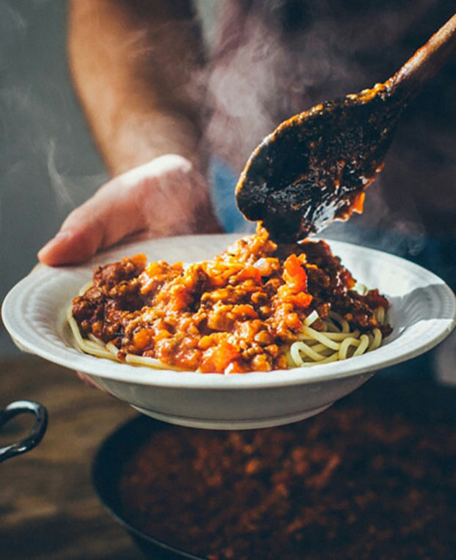
USER
User will be able to :
Register to the application
Sign in to the application
Search for recipes based on the search keyword
Can see selected recipe details
Can also like and comment on the item recipe

Slide 10
USER FLOW
USER
REGISTER
LOGIN
SEARCH
RECIPE
VIEW ALL
RECIPE
SEARCH
RECIPE
LIKE
LOGOUT

Slide 11
DESCRIPTION REGISTER * A user needs to register in order to access the application. * The user needs to enter his/her username, password, phone number . Those information will be stored in the database and will serve as the profile info. LOGIN * Any application operation requires the user to be registered. * Login is the first step before performing an action.
EDIT * The admin will be able to add/remove or endorse the recipe based on his requirement * He will also be able to edit the name, item details and keep it always updated

Slide 12
VIEW INGREDIENTS * The admin and registered user of the application shall be able to view ingredients of a certain recipe. VIEW RECIPES * The admin and registered user shall be able to see all the recipes that is present in the application.
SEACH RECIPES *Any registered user shall able to search for a recipe using the
search bar provided. * The search functionality will provide the users with a shortcut to find their targeted recipes.

Slide 13
USE CASE DIAGRAM ( ADMIN )
APPLICATION
LOGIN
ADD/
DELETE
RECIPE
EDIT
RECIPE
DATABASE
ADMIN
REFRESH
LOGOUT

Slide 14
USE CASE DIAGRAM( USER )
APPLICATION
REGISTER
VIEW ALL
RECIPE
SEARCH
RECIPE
DATABASE
USER
VIEW SELECTED
RECIPE
LIKE

Slide 15
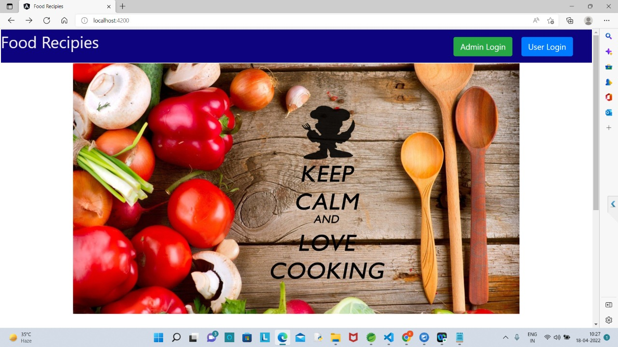

Slide 16
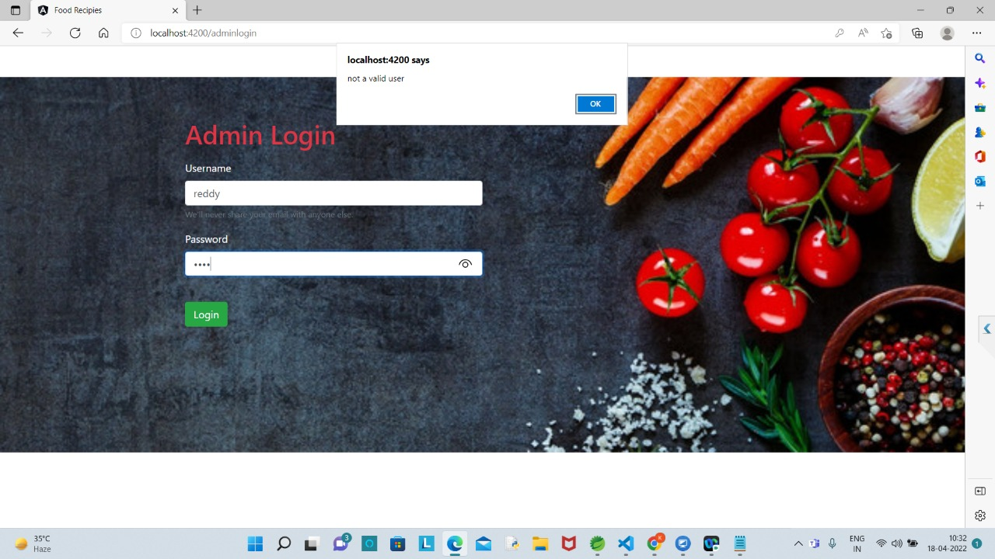

Slide 17
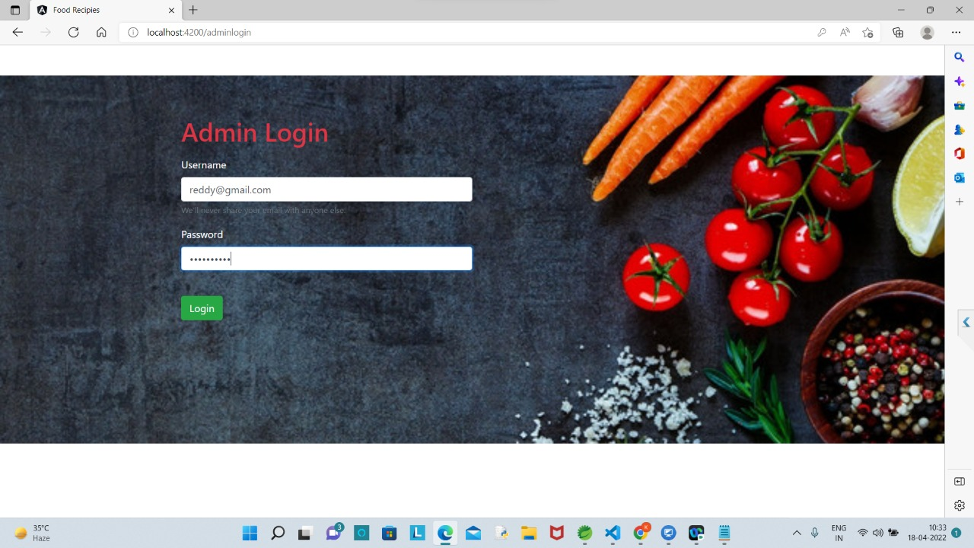

Slide 18
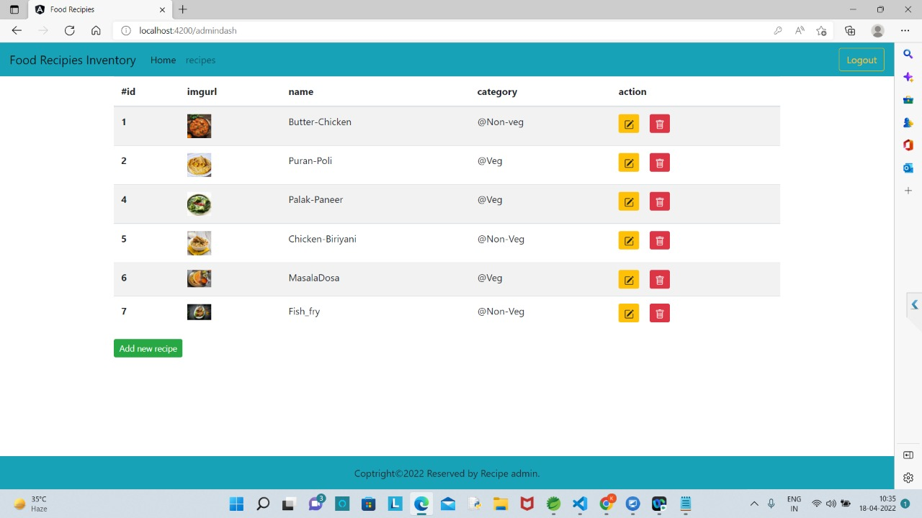

Slide 19
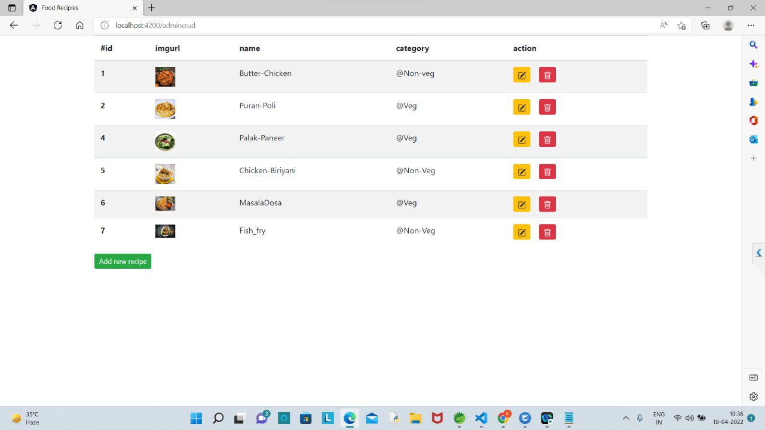

Slide 20
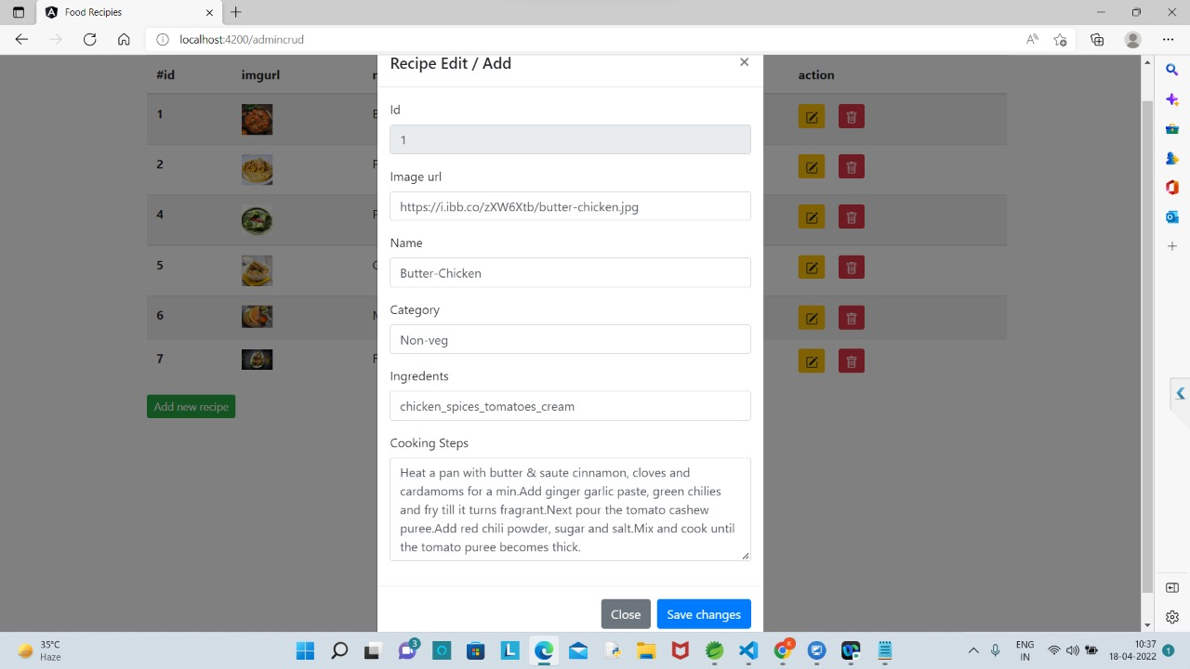

Slide 21
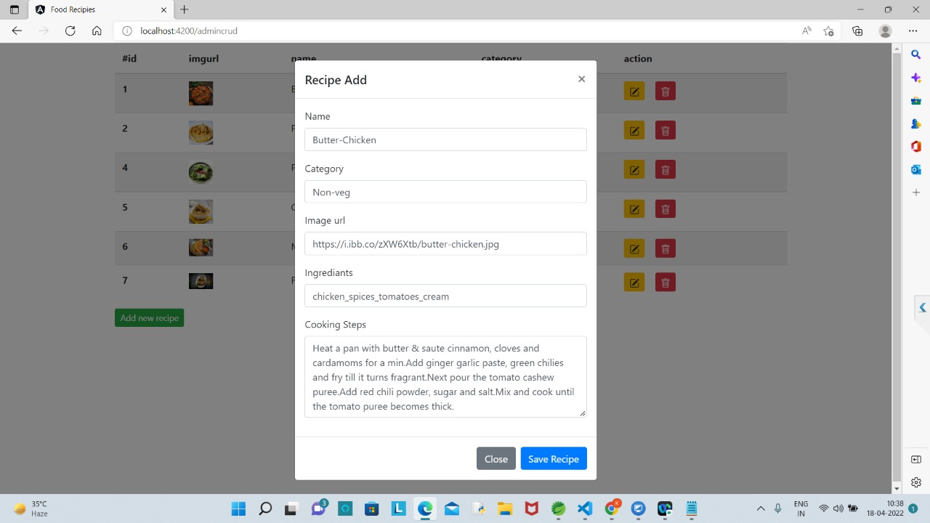

Slide 22
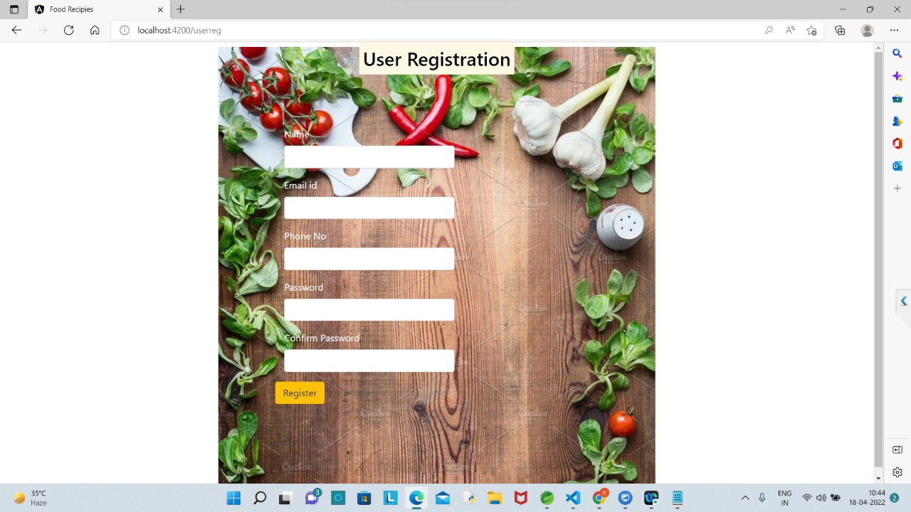

Slide 23
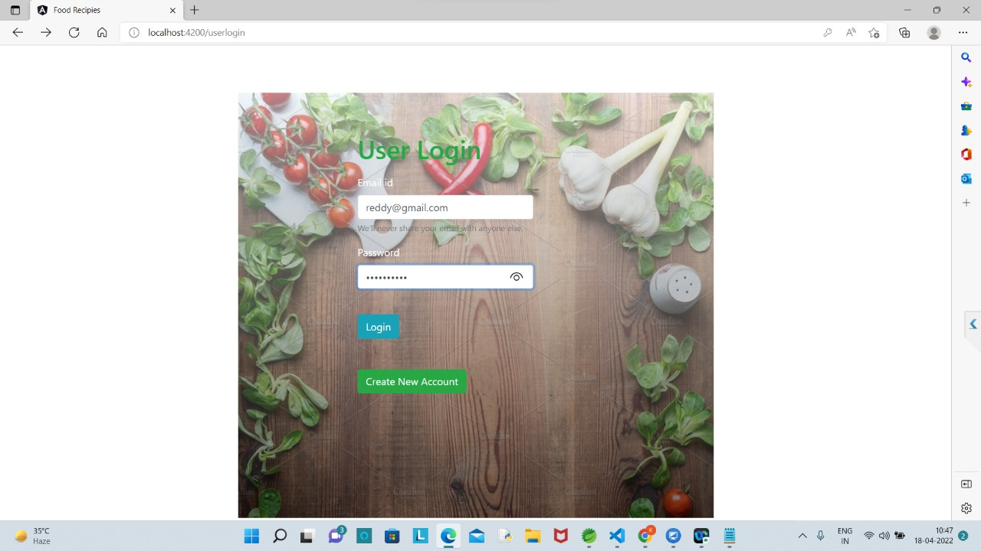

Slide 24
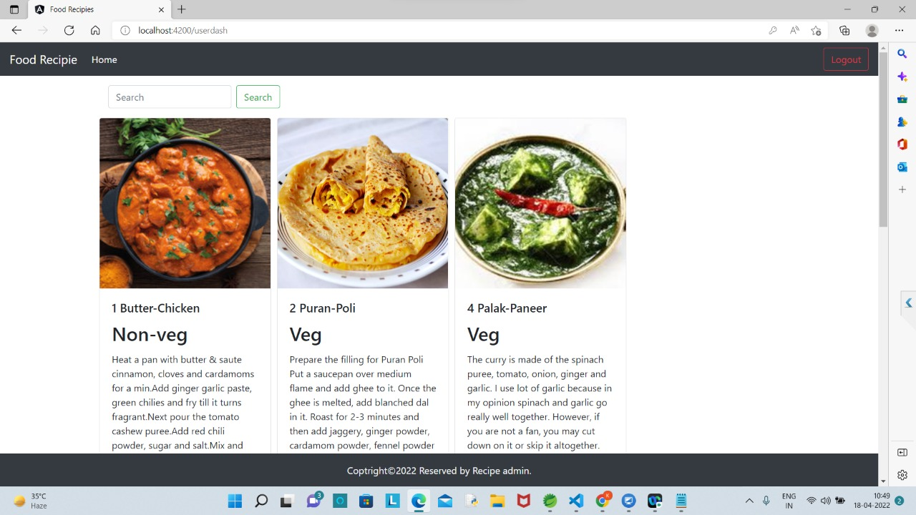

Slide 25
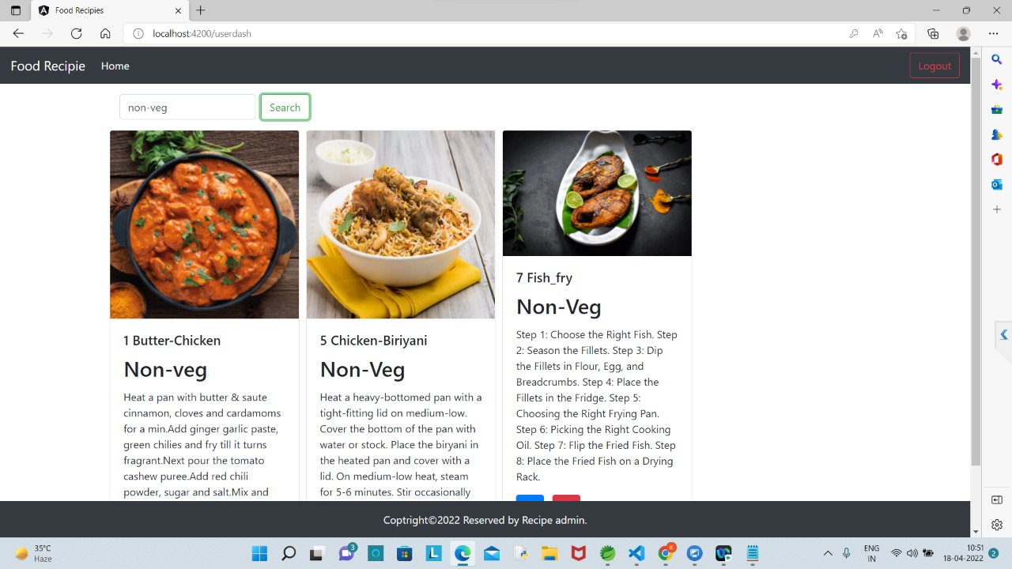

Slide 26
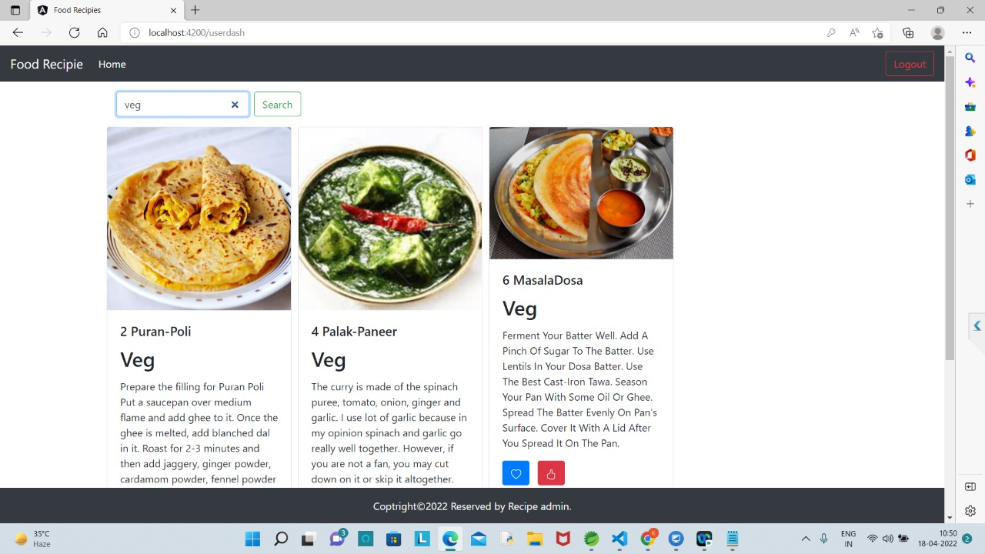

Slide 27
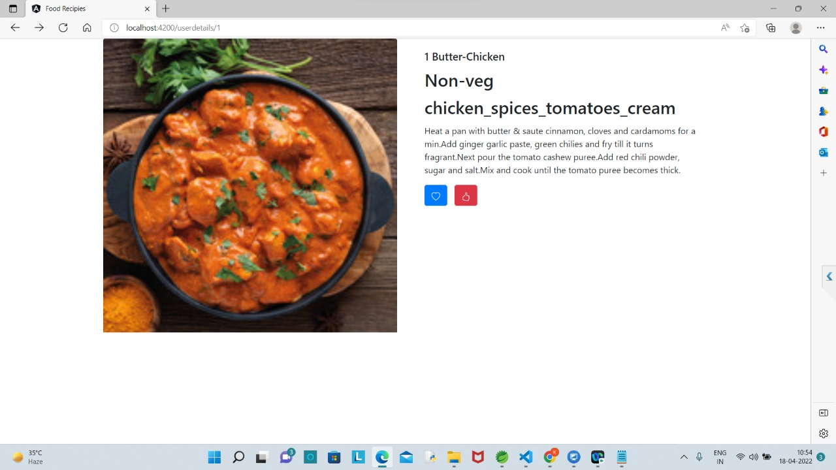

Slide 28
ADVANTAGES * Search for recipes based on the search keyword like item name, item description. * User will be able to sort results based on different categories of the food items. * It ensures the privacy of the users data and secures its access in the database and the maintenance of the application is also easy.

Slide 29
FUTURE WORK * Add more user interface feature. * Promotional offer * Commercialize the web app

Slide 30
CONCULSION
The main objective of the application is to understand the concept and implementation of Java, Spring Boot, Databases and Angular technology.
Our project helps the users to easily find out their choice of taste and recipe.

Slide 31
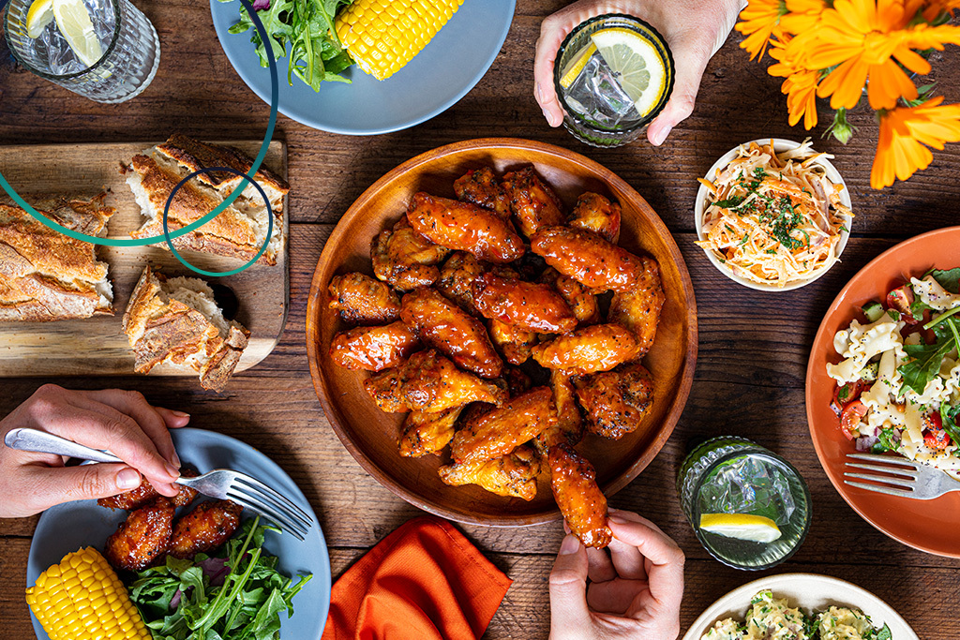


THANKYOU
z

